Slide 1
CSCNSI 2015
Linux System Services

Slide 2
Introduction
System Services
Domain Name Service (DNS)
Dynamic Host Configuration Protocol (DHCP)
Network Time Protocol (NTP)
Network File System (NFS)
HyperText Transfer Protocol (HTTP)
Yum Repositories
Lights Out Management
Authentication and Authorization
Users & Groups
LDAP
Kerberos

Slide 3
System Services

Slide 4

System Services
Service daemons
Run as background processes
Provide services in a way that is transparent to user
Examples:
SSH server (sshd)
IPTables

Slide 5
System Services
Systems that host to many clients tend to have dedicated servers for a single service
Virtualization has allowed many of these servers to operate on the same hardware
Redundant pools of the same server type allow for failure without service interruption

Slide 6
System Services
Service Management
Usually unique to each operating system
Linux uses startup scripts (or systemd)
/etc/rc.d/init.d/
/sbin/service

Slide 7
System Services
Service Management
Linux uses runlevels to indicate what scripts are run under certain circumstances
/etc/rc.d/rc#.d/
/sbin/chkconfig
Runlevel is typically specified in /etc/inittab

Slide 8
System Services
Service Management
Most OSs come with everything on by default
CentOS follows that plug-n-play ideology
You’ll want to remove unnecessary services (like Bluetooth and WiFi)

Slide 9

System Services
Service Management
While configuring your machines
Learn what each service does
Disable what you don’t need
Keep in mind that what your head-node needs
Usually not what your compute-nodes need!

Slide 10
Domain Name Service (DNS)

Slide 11

DNS
Introduction
Translates domain names into addresses
google.com => 74.125.224.132
Most also supply reverse lookups
74.125.224.132 => google.com
Think of it as a queryable address book

Slide 12
DNS
Basics
Servers are organized hierarchically
Queries can be recursive
If a server doesn’t know an answer, the query will be passed up the chain until a solution is found
Data is cached as it comes back down toward the requesting client
Data can expire; requiring another recursion later
< 15 top-level (called ‘root’) servers

Slide 13
DNS
Cluster Situation
Define zones for local machines
Can be arbitrarily named as long as requests return local IP addresses
Benefits include
Reduced outside traffic
Faster responses
Can interact with nodes on a same basis instead of IP addresses

Slide 14
DNS
Client Configuration
Client is configured through /etc/resolv.conf
manually OR automatically by the DHCP client
Configures the:
Domain the client belongs to
What domains to search within
node1 => node1.probe.newmexicoconsortium.org
What nameservers to send queries

Slide 15
DNS
Server Installation
Berkeley Internet Name Domain (BIND)
‘chroot’ version is more secure
Service name | named
Packages | bind; bind-libs; bind-utils; bind-chroot
Configure | /etc/named.conf
Log Files | /var/log/message
Related Commands | dig; host; nslookup

Slide 16
DNS
Configuration
Configuration via:
/var/named/chroot/etc/named.conf
system-conf-bind
Zone files act as local database of names
Each entry is called a record
There are many record types (a; cname; mx)
Man and Google are your friends!

Slide 17
Dynamic Host Configuration Protocol (DHCP)

Slide 18
DHCP
Introduction
Automatic configuration of client network using information provided by server
Average person doesn’t know how to setup:
IP address; DNS; netmask; gateway; routes
First part of Big Picture for network booting

Slide 19
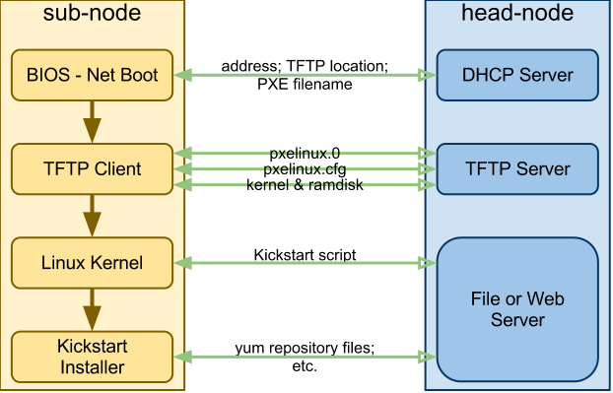

Slide 20
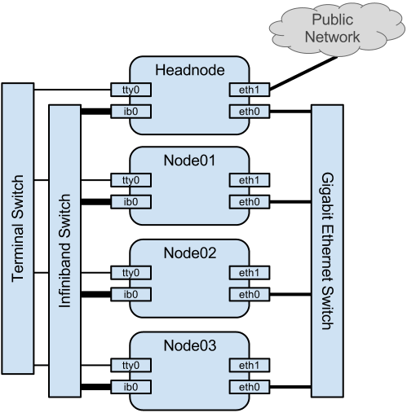
DHCP
Cluster Situation
Provides IPs for nodes based on MAC
Dynamically update DNS
Supply information regarding network booting

Slide 21
DHCP
Message Protocol
When a client connects to the network:
Client broadcasts DHCP DISCOVER
Server response DHCP OFFER
Client responds to first server with DHCP REQUEST
Server acknowledges with DHCP ACK
Renewing client:
Client broadcasts DHCP REQUEST
Server response DHCP ACK

Slide 22
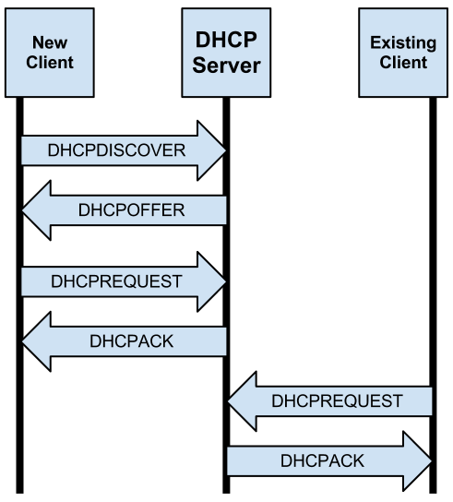

Slide 23
DHCP
Information
IP Address
Netmask
Default gateway
DNS servers
Client hostname

Slide 24

DHCP
IP Addresses
Configurable time-to-live expiration
When the ‘lease’ expires a new one is requested
Addresses can be assigned
‘static’ IP associated with the interface MAC
pulled from a ‘pool’
FAIL

Slide 25
DHCP
Netmask
Defines the location of the three parts to an IP address
Network prefix (10.222.)
Subnet number (.42.)
Host Number (.55)
Two different notations for subnets:
Subnet mask (255.255.0.0)
CDIR (/16)

Slide 26
DHCP
Default Route
Defines the route to the gateway/router
non-subnet traffic is sent to this address
Routing tables can get more complicated than this default

Slide 27
DHCP
Client Configuration
Enable in interface configuration scripts
/etc/sysconfig/network-scripts/ifcfg-eth0
BOOTPROTO=’dchp’
Client runs /sbin/dhclient script
May overwrite /etc/resolv.conf!
Can override served settings using /etc/dhclient.conf

Slide 28
DHCP
Server
Man and Google are your friends!
Log files are invaluable for troubleshooting
Service name | dhcpd
Packages | dhcp dhcp-common
Configure | /etc/dhcp/dhcpd.conf; /etc/sysconfig/dhcpd
Log Files | /var/log/message

Slide 29
DHCP
Server Configuration
Do not smash DHCP broadcasts on the intranet. ONLY LISTEN ON YOUR INTERNAL INTERFACE!
$ cat /etc/sysconfig/network-scripts/route-eth1
255.255.255.255/32 dev eth1
$ cat /etc/sysconfig/dhcpd
DHCPDARGS=eth1

Slide 30
Network Time Protocol (NTP)

Slide 31
Network Time Protocol (NTP)
Server Installation and Configuration
Security
restrict to local network
Service name | ntpd
Packages | ntp
Configure | /etc/ntp.conf
Force sync | /usr/sbin/ntpd -q
Related commands | ntpstat; ntpq

Slide 32

Network Time Protocol (NTP)
Local Time Zone
You may want to set the local timezone
Part of the ‘tz database’
Published as text files
compiled into binary format
located at /usr/share/zoneinfo
# rm /etc/localtime
# ln -s /usr/share/zoneinfo/US/Mountain /etc/localtime

Slide 33
Network File System (NFS)

Slide 34
Network File System (NFS)
Introduction
A centralized filesystem that can be shared over the network
Uses Remote Procedure Call (RPC)
Client-server pattern
Server exports paths
Client mounts exported paths

Slide 36
Network File System (NFS)
Cluster Situation
On a cluster, you can’t simply copy the home directory for every user to every node
Synchronization issues
Waste of storage ($$$)
In the lab we’ll be:
Exporting /home/ to our compute nodes

Slide 37
Network File System (NFS)
Server Installation
Service name | rpcbind; nfs
Packages | rpcbind; nfs; nfs-utils; nfs-utils-lib
Configure | /etc/exports
Related Commands | showmount; mount; umount; df

Slide 38
Network File System (NFS)
Server Configuration
State your exported paths in /etc/exports
Requires rpcbind service to also be running
Difficult to setup securely
Use your firewall
Local root user could have access to all files
This is generally a bad thing

Slide 39
Network File System (NFS)
Client-Side
Packages: nfs-util; nfs-utils-lib; rpcbind
See mounts
showmount -e hostname
Mount manually
mount -t nfs hostname:share path
Mount at boot
Using /etc/fstab

Slide 40
Network File System (NFS)
A Word of Caution
There’s a lot of wrong tutorials on the internet…
As always, make a backup of your system before major changes.
Be very selective with the documentation you use!

Slide 41
HyperText Transfer Protocol (HTTP)

Slide 42
HyperText Transfer Protocol (HTTP)
Introduction
Many servers
Apache and NGINX are most common
We’re using Apache in this course
Host repository files during installation
Anaconda uses this protocol
Later we’ll host the same repository files using NFS

Slide 44
HyperText Transfer Protocol (HTTP)
Cluster Usage
Hosting files
Internally
Yum repositories for netbooting
Configuration files
Hosting web accessible monitoring services
Externally
we’ll be doing this later

Slide 45
HyperText Transfer Protocol (HTTP)
Installation
Lots and lots of settings
Well documented
Service name | httpd
Packages | apache
Configure | /etc/httpd/conf/httpd.conf; /etc/httpd/conf.d/*.conf
Log Files | /var/log/httpd/

Slide 46
Yum Repositories

Slide 47
Yum Repositories
Introduction
Local Copy
Reduces network traffic
Speeds installation
Can easily add local packages
Can distribute fixes now, instead of waiting
Can extend the OS with compiled applications
Ensures (at least some) availability

Slide 49
Yum Repositories
Process
Create local repository mirror on head node
Update regularly from source
Instructor’s server
Publish via HTTP for network booting
Publish via NFS for regular yum updates

Slide 50
Yum Repositories
rsync
Find a mirror that serves repos via rsync
cscnsi.newmexicoconsortium.org
Mirror the mirror using rsync
Run createrepo to generate metadata
Later:
Update the mirror using rsync’
Run createrepo --update to regenerate metadata

Slide 51
Yum Repositories
HTTP and NFS Hosting
Use HTTP for the Anaconda/Kickstart netbooting process
Use NFS for yum updates/installs on configured nodes

Slide 52
Yum Repositories
Client Configuration
Create a repo config and place in /etc/yum.repos.d/
Ensure it points to your published repos
Ensure that GPG keys are present on the client
Or not checked by client
Enable repos as you need them
Consider installing yum-plugin-priorities on the clients to resolve conflicts automatically

